Slide 1
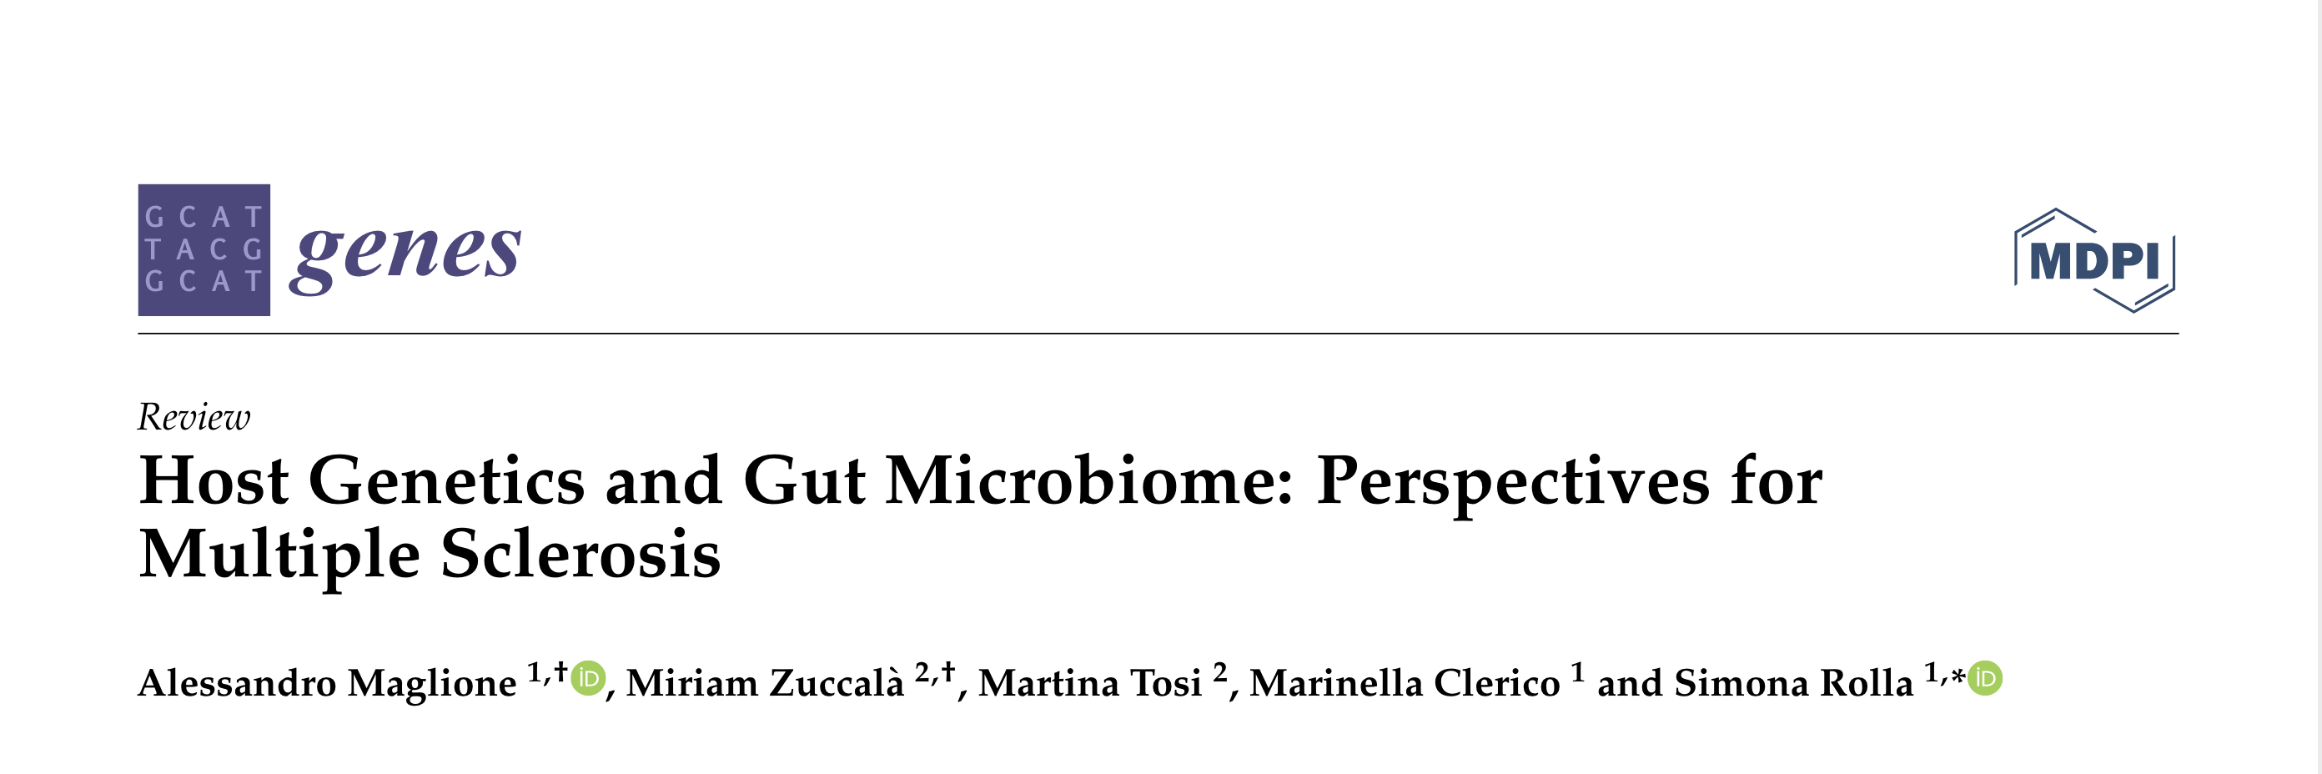
Host Genetics and Gut Microbiome: Perspectives for Multiple Sclerosis
2021
A layperson’s summary
Notes:
Hard to summarise a paper with this amount of content in 10 mins, so cut a lot and tried to pull out the key components
And this really is a lay response – I think I understood about 70% of the paper and perhaps 50% of the complex implications and interactions it was describing

Slide 2
tldr
Strong experimental and theoretical reasons to believe an association between genetics, the microbiome, and the cause and progression of MS
HOWEVER, at the level of individual genes, genomes and bacteria this association is complex and hard to prove
AND, the understanding of host genetic and gut microbiome composition could be a challenge for designing personalised therapeutic strategies
SO, in the short term, does the question for us become how we evaluate claims about dietary effects on the microbiome and hence MS?
Notes:
In terms of the last question, or whether we even should at this stage given the state of knowledge?

Slide 3
Some context …
MS is caused by both genetics and the environment
And the gut biome is an important environmental factor.
But, we don’t know much about its interaction with genetics
Notes:
I can’t get into papers like this without giving myself some firm foundations. This slide and next are creating my foundations

Slide 4
… and some definitions
Microbiota: The many different types of microorganisms, bacteria, archaea, fungi, and viruses, living on our bodies
Microbiome: The collective genomic, protein, and metabolite content of all the microbes in this ecosystem
Gut microbiome: those microbes living in the gut which make up 95% of the overall microbiome
TH17: T-helper cell 17, associated with MS
Fun fact: the number of genes in the microbiome is 100x larger than the human genome

Slide 5
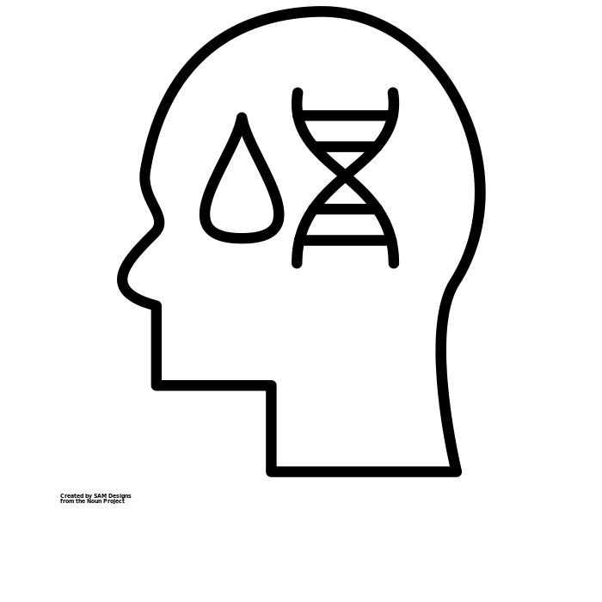
What this paper does 1
Gut biome
Immune system
Central nervous system
Wider health
Notes:
It looks at what we know of the genetic factors related to MS
at the interactions between the immune system, gut microbiome
and CNS.
Worth remembering that the gut biome (and obvs immune system) both also have an impact on wider health directly
It summarises the evidence from mouse models and studies in patients, and
(because evidence is scant) look at the interplay of genetics with the environment in other diseases - Inflammatory Bowel Disease, Rheumatoid Arthritis and Systemic Lupus Erythemotosus).

Slide 6
What this paper does 2
Provides a good overview of current theory about initiation and progress of MS (not going to summarise here*)
Of importance to this paper is that:
Genetics accounts for 30% of disease susceptibility
Before genome-wide association studies only genetic factor for susceptibility was Histocompatibility Complex accounting for 48% of susceptibility
What this study is partly attempting to do is tease out the missing 52%
SPOILER: it’s a bit too complex for us to be able to tell really
*See powerpoint notes for my summary or pp1-2 of paper
Notes:
Introduction: MS is the leading cause of non-traumatic disability in young adults in Europe.
Current disease activation is described as the initial activation of self-reactive T and B lymphocyts in peripheral lymph nodes and their differentiation into effector cells (relatively short-lived activated cells that defend the body in an immune response.)
CD4+ T cells are the most involved. Pro-inflammatory T helper cells are activated in the periphery following a deficit of regulatory T lymphocytes which lose the ability to stop the autoreactive response. The breakdown of the blood brain barrier (BBB) (allowing the T-helper cells into the CNS) is an early stage of disease progression. Once past the BBB antigen presenting cells (APCs - which appear to be part of the immune response and not just any cell with the right antigen) reactive the T helper cells.
The activated immune system then reacts against myelin. Inflammation is supported by cytokines and chemokines and the recruitment of other self-reactive cells from the periphery.
[p2] There’s a feedback loop involving B cells producing antibodies which keep the CD4+ T cells active. In later stages of the disease the inflammatory response is supported by the activation of microglia leading to chronic neurodegeneration.
Worth noting also:
MS is not heritable
People may have a genetic susceptibility
Genetics accounts for 30% of disease susceptibility
Recurrence in families is 20%
Twin studies show that its 3-5% between siblings

Slide 7
The microbiome and MS – mouse models
First evidence of a link from mice models
Germ free mice are associated with milder EAE*
Unsurprising because these mice have severely defective immune systems
Possible component of the mechanism is that microflora may affect the BBB ±
Different bacteria have different effects
SFB is regulated by cytokines and the gut barrier
Breaching the latter leads to a Th17 response to neutralise the invasion
There’s a complex feedback loop which leads to autoreactive Th17 cells
Cacteroides fragilis by contrast promotes immune homeostasis
It expresses a polysaccharide which protects mice from EAE by supressing Th17 responses
Giving this polysaccharide orally helps promote an anti-inflammatory response
*Experimental Autoimmune Encephalomyelitis ± Blood Brain Barrier

Slide 8
The microbiome and MS – in patients
Don’t get too excited
We’re very early into investigations
Limited to individual case studies vs health controls
What have we found?
Some changes in microbiome detected between people with MS & controls
But vary between studies (ethnicity, lifestyle and background may have more effect)
Paper quotes
5 studies identifying 9 bacteria which are found in decreased abundance
5 studies (some the same) identifying 8 bacteria in increased abundance

Slide 9
Some hypotheses
Two of the bacteria in lower abundance produce SCFAs*
SCFAs associated with decreased inhibition of the immune inflammatory response
Ie these bacteria produce something which might lead to more inflammation
MS patients have increased immunoreactivity to Epsilon toxin produced by another bacterium
Toxin binds to myelin and to the BBB
It is a candidate for lesion formation in MS
Other bacteria have other effects including
Dendritic cell activation
Pro-inflammatory effects on cells with adaptive. Immunity
Impairing the ability to promote the differentiation of Treg± cells
*short chain fatty acids ±T-Regulation cells

Slide 10
The microbiome, immune system, genetics and autoimmunity
Gut biome
Immune system
Central nervous system
Wider health
autoimmunity
But no studies have yet connected host genetics to the microbiome in MS… yet…
host and microbiome genetics
Notes:
Focusing in on the influence of the gut biome on immune responses
The genetics of both the host and microbiome has an impact on the immune response
And taken together these could have a fundamental role in the development of autoimmunity
Which in turn could lead to CNS damage
Especially in diseases where genetic factors interact with environmental ones inc MS
However no studies have yet connected host genetics to the microbiome in MS

Slide 11
Conclusion
Role of microbiome in MS is complex and unclear
There is a clear role of microbiome in gut-brain axis and thus in CNS diseases
And, dysbiosis is present in MS patients, but we don’t know the specific signature
studies too small, not diverse enough etc.
However, gut biome is a factor which could contribute to disease risk
So, need to understand how the host genetics affects gut microbiome composition
Understanding this could help explain some of the missing heritability
Paper ends on a negative note “Overall, the comprehension of host genetics and gut microbiome composition at the onset of the disease could be a challenge for the design of personalized therapeutic strategies”

